Slide 1


COLLEGE
NETWORK
COMPUTER NETWORK LAB
ABUBAKR KHANOONI-A2 27
DEVASHREE AMBEGAOKAR-A1 03
ANKIT BHAD-A2 34
AYUSH TALPELWAR-A2 39

Slide 2

CONTENT
01
INTRODUCTION AND NETWORK OVERVIEW
02
IMPLEMENTATION AND FLOW DIAGRAM
03
CONFIGURATION AND SECURITY
04
RESULT AND CONCLUSION
05
FUTUTRE WORK

Slide 3


INTRODUCTION
Aim: The aim of this project is to design the topology of the university network using the software Cisco Packet Tracer with the implementation of wireless networking systems.
Simulation focuses on campus network using wireless networking for mobility and efficiency.
Divided into campus and hostel areas to showcase connectivity within university premises.
Objective: Highlight wireless connectivity in universities for mobile and efficient networking.
Emphasis on mobility; aim to offer equal functionality to all users (staff, students).
Services provided: DNS, Email, HTTP servers for resource utilization.
Functions include internet connectivity, data sharing among users, accessing web services.
Wireless networking essential for seamless processing and access to various functionalities.

Slide 4
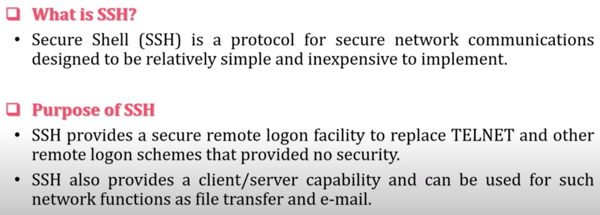
SECURE SHELL PROTOCOL

Slide 5
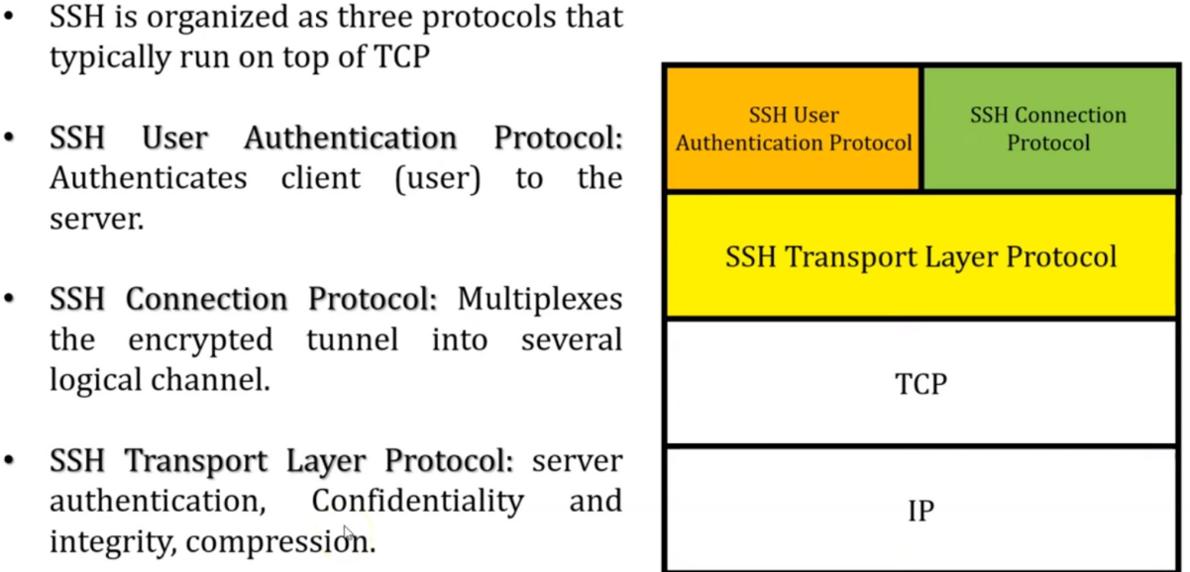
SSH PROTOCOL STACK

Slide 6
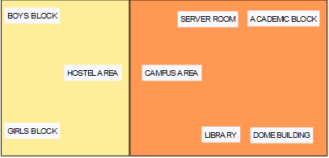
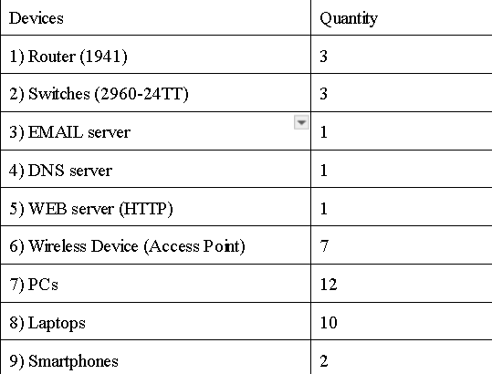
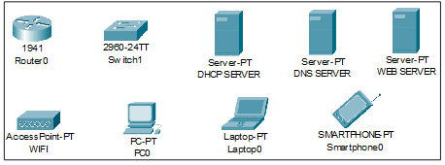
NETWORK OVERVIEW
Network Requirement
Number of Devices Used
Devices used in our Network

Slide 7
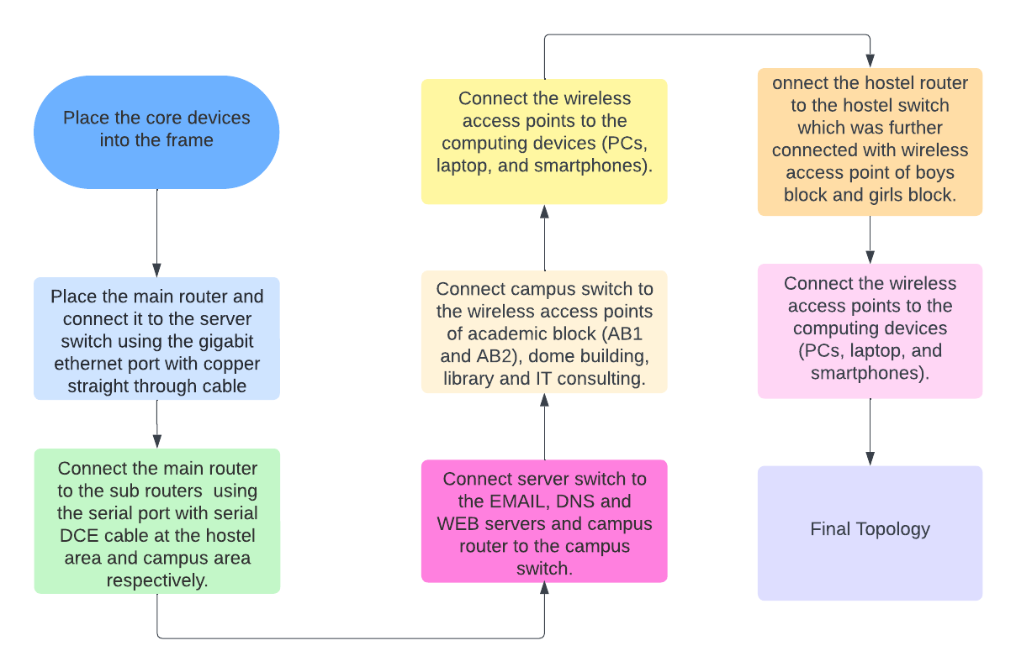

IMPLEMENTATION AND FLOW CHART
c

Slide 8
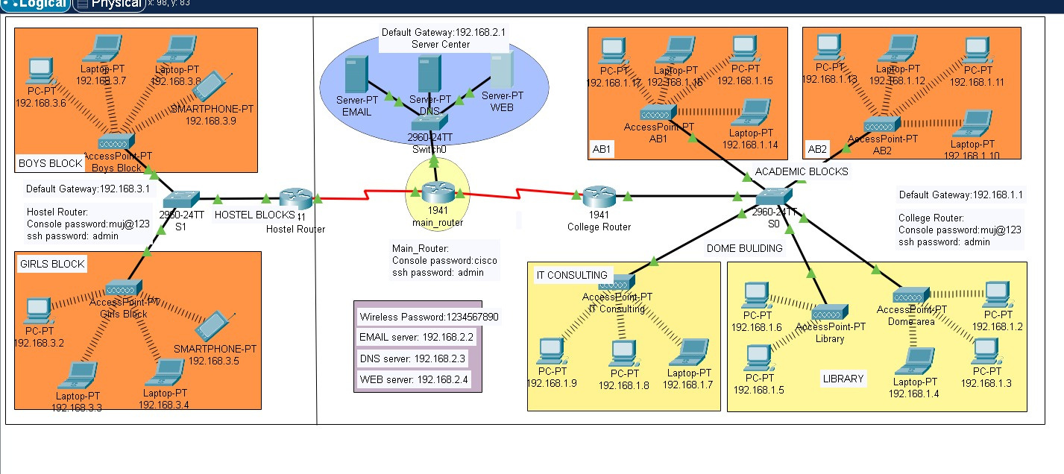
DESIGN OF THE NETWORK

Slide 9
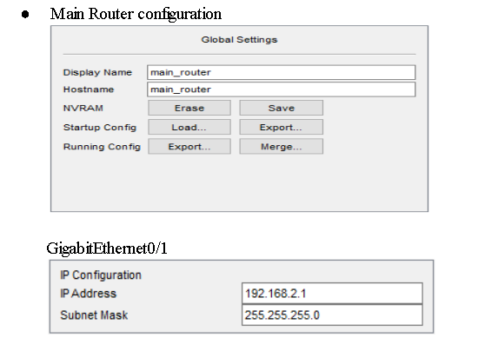
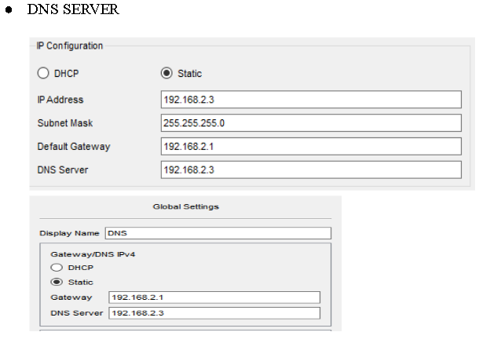

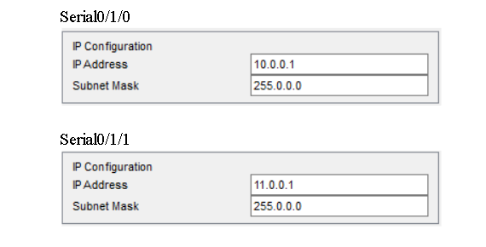
CONFIGURING IP ADDRESSES

Slide 10
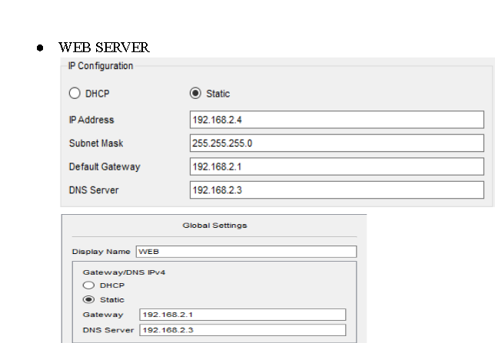
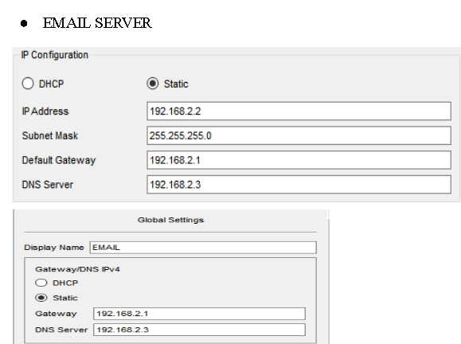
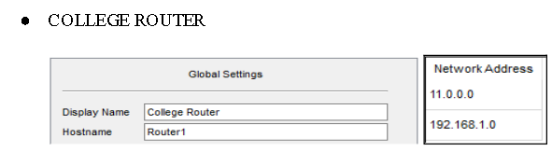
CONFIGURING IP ADDRESSES

Slide 11
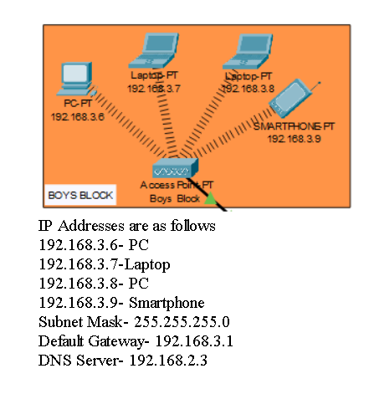
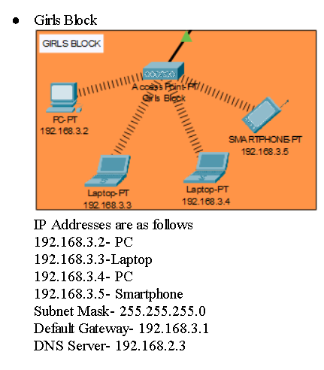
CONFIGURING IP ADDRESSES

Slide 12
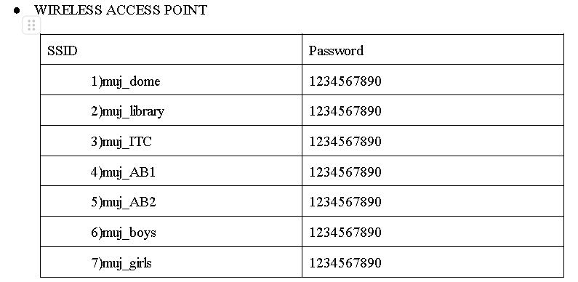
CONFIGURATION
Each Section will have a seperate wifi and password to ensure security and reliability

Slide 13
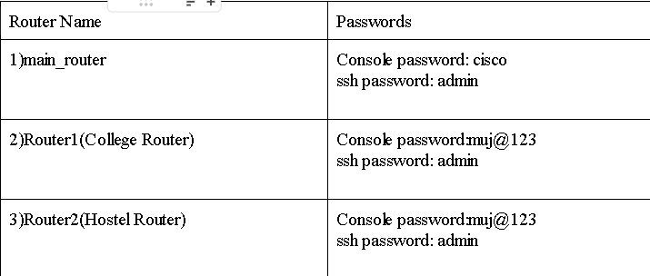
CONFIGURATION
All main routers will have admin access to configure the terminal and not everyone will have the access to it , particular router having different password

Slide 14
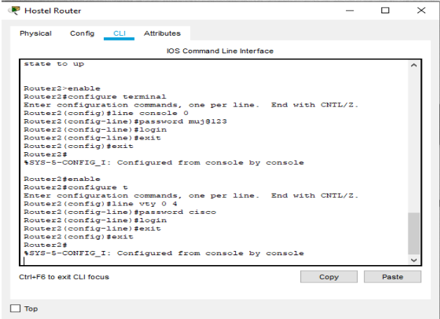
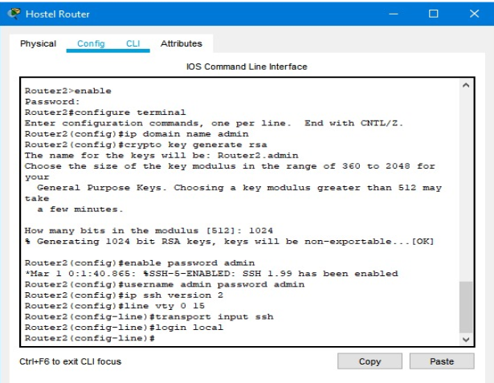
SSH-CONFIGURATION

Slide 15
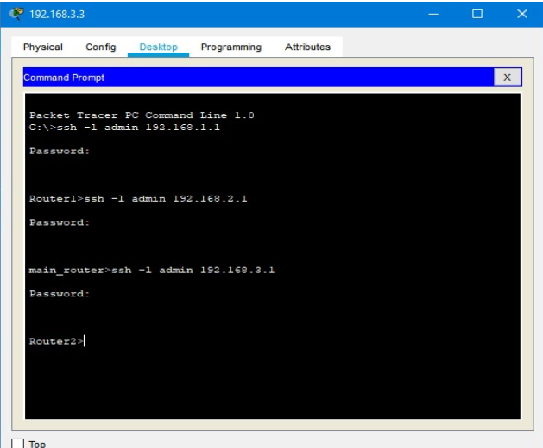
SSH-CONFIGURATION

Slide 16
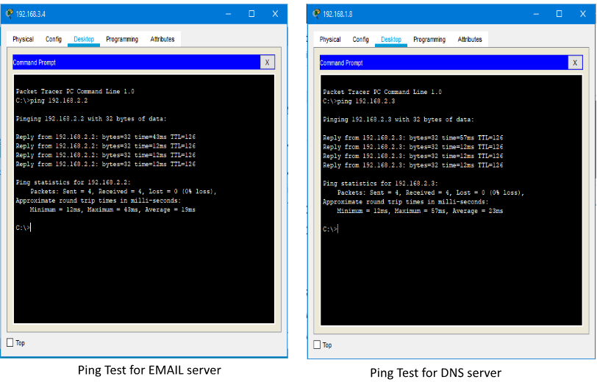
PING TEST

Slide 17
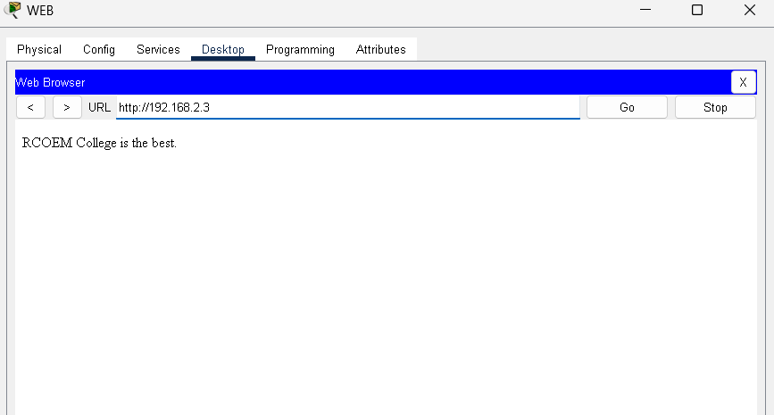
WEB ACCESS

Slide 18
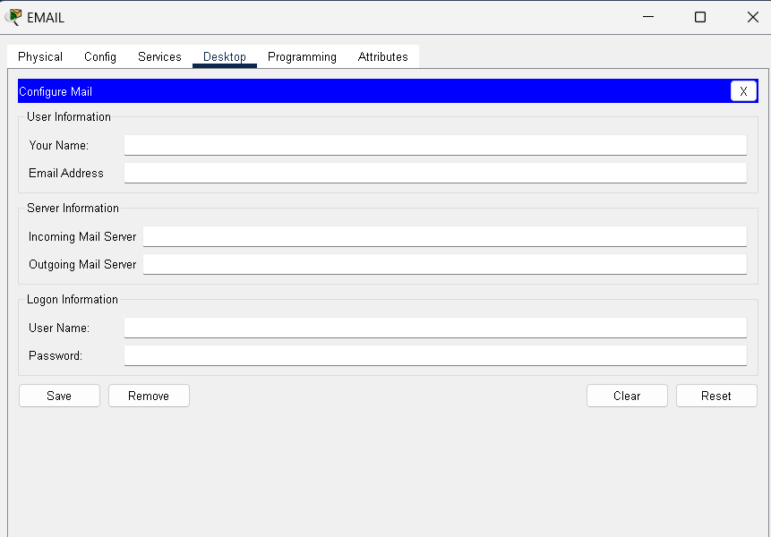
EMAIL SERVICE

Slide 19
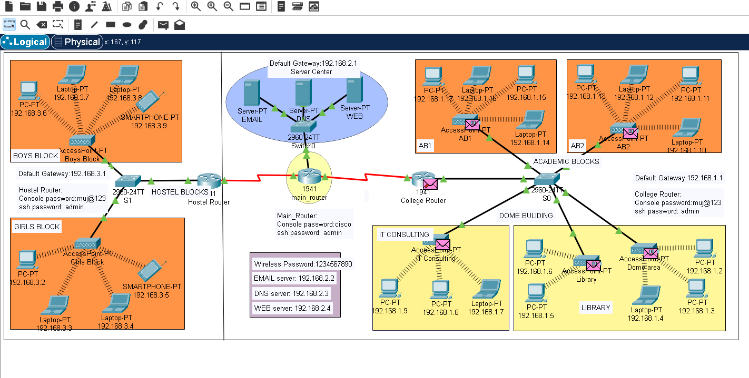
FINAL NETWORK

Slide 20
RESULT
OBJECTIVE:
DIGITALIZATION: INITIATED WITH THE GOAL OF MODERNIZING EDUCATIONAL PRACTICES THROUGH TECHNOLOGICAL INTEGRATION.
WIRELESS NETWORK DESIGN: FOCUSED ON ENHANCING MOBILITY AND EFFICIENCY WITHIN THE UNIVERSITY ENVIRONMENT.
COMPONENTS INTEGRATED:
TOPOLOGY: UTILIZED SERVERS, ROUTERS, SWITCHES, AND END DEVICES IN A MULTI-AREA NETWORK SETUP.
SERVER FUNCTIONS: DNS SERVER, WEB SERVER, AND EMAIL SERVER IMPLEMENTED FOR SMOOTH COMMUNICATION ACROSS DIFFERENT AREAS AND WITHIN THE UNIVERSITY DOMAIN.
SECURITY MEASURES: EMPLOYED CONSOLE PASSWORDS AND SSH PROTOCOL TO ENSURE SECURE DATA TRANSFER.
ACHIEVEMENTS:
SUCCESSFULLY IMPLEMENTED A FUNCTIONAL AND SECURE WIRELESS NETWORK CATERING TO THE NEEDS OF STUDENT-TEACHER COMMUNICATION.
ESTABLISHED A CLEAN AND EFFICIENT NETWORK INFRASTRUCTURE, REPLACING A WIRED SETUP FOR ENHANCED USABILITY.

Slide 21
CONCLUSION AND FUTURE ENHANCEMENT
CONCLUSION:
EFFICIENCY: ACHIEVED IMPROVED MOBILITY AND EFFICIENCY THROUGH THE DEPLOYMENT OF A WIRELESS NETWORK.
FUNCTIONALITY: INTEGRATED ESSENTIAL SERVER FUNCTIONS FACILITATING SEAMLESS COMMUNICATION AMONG STUDENTS, TEACHERS, AND INTRA-UNIVERSITY DEPARTMENTS.
SECURITY: ENSURED DATA SECURITY THROUGH CONSOLE PASSWORDS AND SSH PROTOCOL, PRIORITIZING SAFE DATA TRANSMISSION.
FUTURE DEVELOPMENT:
SCALABILITY: PLAN TO FURTHER DEVELOP THE NETWORK FOR INCREASED SUPPORT AND COVERAGE.
ADDITIONAL FUNCTIONALITY: CONSIDERATION OF ADDING MORE FEATURES TO EXPAND AND ENHANCE THE EXISTING NETWORK'S CAPABILITIES.
OPTIMIZATION: CONTINUAL OPTIMIZATION OF CONFIGURATIONS AND SPECIFICATIONS TO ADAPT TO EVOLVING TECHNOLOGICAL NEEDS.

Slide 22
REFERENCES
HTTPS://EN.WIKIPEDIA.ORG/WIKI/PACKET_TRACER
HTTPS://WWW.PAESSLER.COM/IT-EXPLAINED/SERVER
HTTPS://COMPUTERNETWORKING747640215.WORDPRESS.COM/2018/07/05/SECURE-SHELL-SSH-CONFIGURATION-ON-A-SWITCH-AND-ROUTER-IN-PACKET-TRACER/
HTTP://ROUTER.OVER-BLOG.COM/ARTICLE-HOW-TO-CONFIGURE-CISCO-ROUTER-PASSWORD-106850439.HTML
HTTPS://WWW.COGNOSCAPE.COM/BENEFITS-GOING-WIRELESS/

Slide 23


